Slide 1
Data Structure
Course code: cs-201
Topic: Queue

Slide 2
Goals for today
To introduce :
Circular queues
Double-ended queues (Deque)
Priority queues

Slide 3
CLO Covered
CLO1: Explain the fundamentals of data structure as well as algorithms that operate on them GA2, BT C2
CLO2: Apply and design various data structures methods for specified applications. GA4, C3

Slide 4
Algorithm for Enqueue using Link list
Here ‘front’ and ‘rear’ are like start and last node of linked list
struct node *newnode = new (struct node);
newnode->data=item;
newnode -> link = -1;
If (front==-1 && rear==-1) // if there is no element in the queue
front=rear=newnode;
Else
rear->link=newnode;
rear = newnode;

Slide 5
Algorithm for Dequeue using Link list
Struct node *temp
Temp = front
if(front==0 && rear==0) // no element in the queue
underflow
else
Print: front->data
front=front->link;
Free(temp)

Slide 6
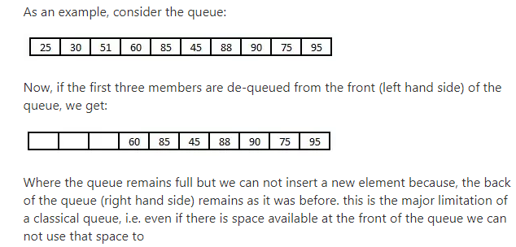
Why circular queues are needed

Slide 7
Circular arrays
We can treat the array holding the queue elements as circular (joined at the ends)
0 1 2 3 4 5 6 7
myQueue:
44
55
11
22
33
rear = 1
front = 5
Elements were added to this queue in the order 11, 22, 33, 44, 55, and will be removed in the same order

Slide 8
Full and empty queues
If the queue were to become completely full, it would look like this:
0 1 2 3 4 5 6 7
myQueue:
44
55
66
77
88
11
22
33
rear = 4
front = 5

Slide 9
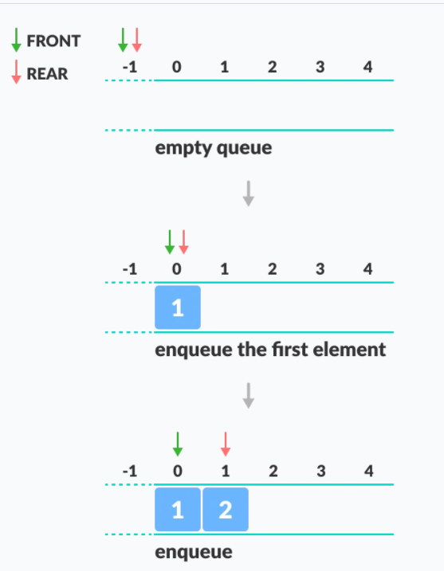
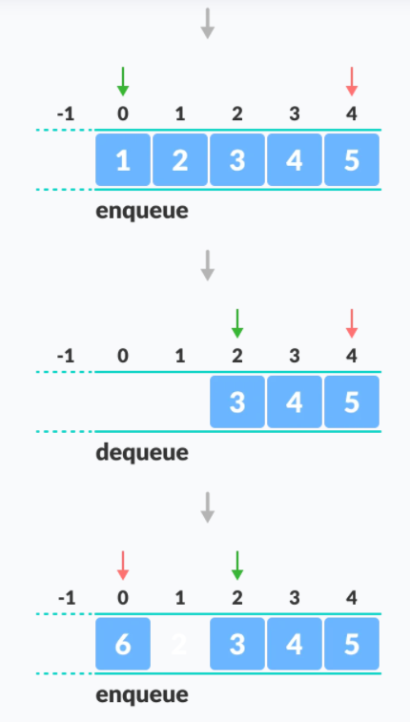
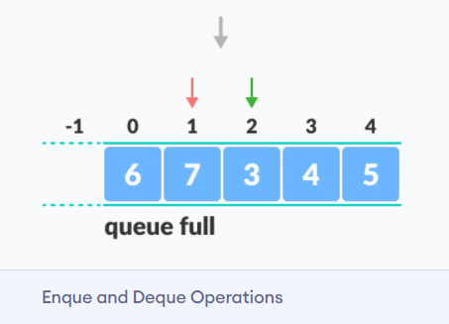
Circular Queue

Slide 10
Activity
Consider the following queue of characters, where QUEUE is a linear array which is all allocated six memory cells: FRONT = 2, REAR = 4
QUEUE: __ , A, C, D, __ , __
Describe the queue as the following operations:
F is added to the queue
Two letters are deleted
K, L, and M are added to the queue
Two letters are deleted
S is added to the queue
Two letters are deleted

Slide 11
Activity
Maintain a circular array QUEUE with N=5 memory locations. Observe that queue always occupies consecutive locations expect when it occupies locations at the beginning and at the end of the array. Perform the following operations on initially empty queue.
Front :0 Rear 0
Enqueue A, B and C.
Dequeue A
Enqueue D and then E
Delete B and C
1 | 2 | 3 | 4 | 5
Enqueue F
Dequeue D
Enqueue G and H
Dequeue E and F
Enqueue K
Dequeue G and H

Slide 12
Example
Maintain a circular queue with five elements. Initially list is empty. Insert three elements a,b,c. what will be your front and rear.
Delete a, insert d and e, delete b and c, insert f, delete d, insert g and h, delete e, delete f, insert k, delete g,h, delete k.
Tell about your front and rear at each step.

Slide 13
Overflow and underflow condition in circular queues
If ((rear+1)=front) then print overflow
If (front=-1 and rear=-1) then print underflow

Slide 14
Circular Queues algorithms using array
Insertion:
If( ( (rear+1) % N) == front )
Overflow
elseif (front=-1 && rear=-1
front=0; rear=0;
Queue[rear] = data;
Else
rear=(rear+1)%N
queue[rear]=item;
Notes:
(0+1)%5 = 1
(1+1)%5=2

Slide 15
Circular Queues algorithms using array
Deletion:
if (front=-1 and rear=-1) then print underflow
else if (front==rear) then //having only one element
front=-1; rear=-1;
else
front=(front+1)%N;

Slide 16
Applications of circular queues
Memory management
Process scheduling

Slide 17
Double-ended queues
Double-ended queue is a more generalized form of queue data structure which allows insertion and removal of elements from both the ends, i.e , front and rear.
It is implemented using circular queues.
Two types:
input-restricted deque
output-restricted deque

Slide 18
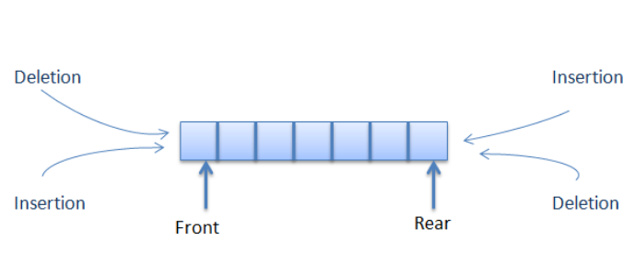
Pictorial representation of deque

Slide 19
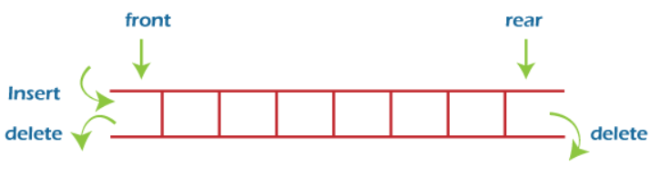
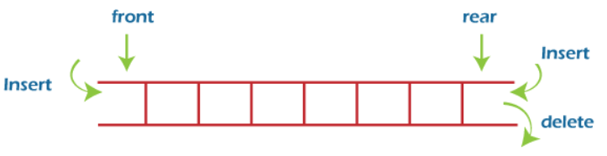
Types of Double-ended queues
An input-restricted deque is one where deletion can be made from both ends, but insertion can be made at one end only.
An output-restricted deque is one where insertion can be made at both ends, but deletion can be made from one end only.

Slide 20
Applications of double-ended queues
They can be used in job scheduling algorithm.
This algorithm implements task scheduling for several processors. A separate deque with threads to be executed is maintained for each processor. To execute the next thread, the processor gets the first element from the deque .
Undo-redo operations in software applications.

Slide 21
Priority queue
Priority Queue is an extension of queue with following properties:
Every item has a priority associated with it.
Each element is inserted or deleted on the basis of their priority.
If two elements have the same priority, they are served according to their order in the queue “first come first serve (FCFS)”.
Priority queues are different from queues in the sense that they do not act on the FIFO principle.
Data | Priority no. | Link

Slide 22
Two types of priority queues:
Ascending order priority queue (lower priority no. to higher priority no.)
Descending order priority queue (higher priority no. to lower priority no.)

Slide 23
One of the real world example would be Priority Scheduling algorithm where each job is assigned a priority and the job with the highest priority gets scheduled first.

Slide 24
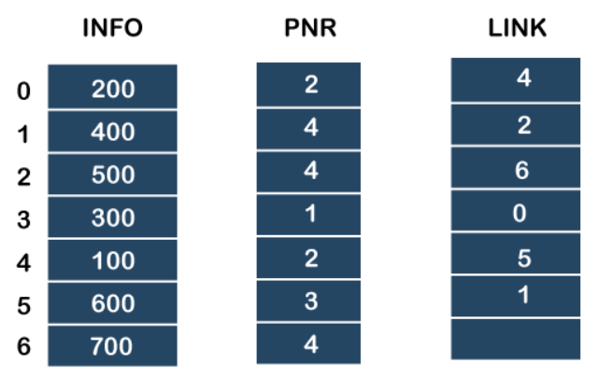
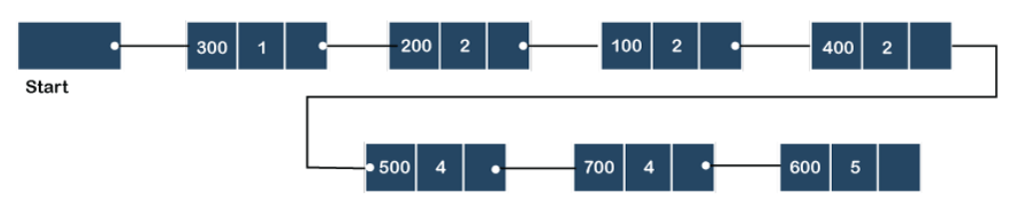
5
4

Slide 25
Example
Consider the linked list and apply following operations:
Insert ‘10’ with priority ‘1’.
Insert ‘20’ with priority ‘1’.
Insert ‘25’ with priority ‘3’.

